Slide 1


Eileen
Data Scientist
2025-01-15

Slide 2

Outline
Executive Summary
Introduction
Methodology
Results
Conclusion
Appendix

Slide 3
Executive Summary
Summary of methodologies
Data Collection
Data Wrangling
EDA Analysis
Data Visualization
Machine Learning
Summary of all results
There are relationships between parameters and Decision Tree is the best ML model

Slide 4
Introduction
Project background and context
Space Y would like to compete with Space X which has Falcon 9 rocket launches and is the most successful company in the world.
We have open-resource data which is published by SpaceX team, where we are able to make data-driven decision based on analysis
Problems you want to find answers
The possibility of SpaceX reusing the first stage
The relationship between Parameters and Success of Launch

Slide 5

Section 1

Slide 6
Methodology
Executive Summary
Data collection methodology:
Use API to get SpaceX’s past launch data and format it into dataframe
Perform data wrangling
Categorize all outcomes into ‘Success’ or ‘Failure’ and assign numeric value (1 or 0) to categories
Perform exploratory data analysis (EDA) using visualization and SQL
Perform interactive visual analytics using Folium and Plotly Dash
Perform predictive analysis using classification models
Normalize data, split dataset into training and testing, use GridSearchCV to comparing the accuracy of predicting results

Slide 7
Data Collection
Describe how data sets were collected.
Use API to get SpaceX’s past launch data by performing get request
Format it from json into cvs dataframe with json_normalize OR from html into cvs dataframe with beautifulsoup

Slide 8
Data Collection – SpaceX API
Workflow of REST API
https://github.com/EileenWashU/capstopne_y/blob/main/jupyter-labs-spacex-data-collection-api%20(1).ipynb
URL
requests.get()
Response_json
pd.json_normalize()
Final_ Dataframe
Missing value replace with Mean
Raw_ Dataframe

Slide 9
Data Collection - Scraping
Workflow of webscraping
https://github.com/EileenWashU/capstopne_y/blob/main/jupyter-labs-webscraping%20(1).ipynb
URL
requests.get()
Response_html
BeautifulSoup object
Extract values from html table to disctionary
Final_ Dataframe

Slide 10
Data Wrangling
Workflow as below
Get statistical information from data using value_counts
Classify outcomes into numeric value with 1 representing good outcome while 0 as bad outcome
https://github.com/EileenWashU/capstopne_y/blob/main/labs-jupyter-spacex-Data%20wrangling%20(1).ipynb
IsNull()
Replace with Mean
Replace with Mean
Count Values for columns
New column for outcomes with 0 and 1

Slide 11
FlightNumber vs. PayloadMass
FlightNumber vs. PayloadMass
EDA with Data Visualization
Scatter plots of FlightNumber VS PayloadMass for relationship
Scatter plots of FlightNumber VS LaunchSite for relationship
Scatter plots of PayloadMass VS LaunchSite for relationship
Scatter plots of FlightNumber VS Orbit for relationship
Scatter plots of PayloadMass VS Orbit for relationship
Bar chart of SuccessRate per each Orbit for best orbit
Line Chart for yearly success rate from 2010 to 2020 to observe maturity
https://github.com/EileenWashU/capstopne_y/blob/main/edadataviz%20(1).ipynb

Slide 12
EDA with SQL
Start a database
Distinct Launch Site
First 5 records with Launch Sites starting with ‘CCA’
Calculate total playloads for NASA, average playloads for F9 v1.1 version booster, total number of success and failure outcome
Date of first successful Ground Pad landing
All boosters had successful drone ship with payloads from 4000 to 6000
All booster versions with max payloads
Months in 2015 had failed drone ship
Rank of landing outcomes counts
https://github.com/EileenWashU/capstopne_y/blob/main/jupyter-labs-eda-sql-coursera_sqllite%20(1).ipynb

Slide 13
Build an Interactive Map with Folium
Folium Map has objects like Markers, Marker_cluster, Circle, Mouse-position, Lines
Markers to flag points of launch sites / coastline / city / railway,
Marker_cluster to display all outcomes for each launch site
Circle for range of launch points and highlight it,
Mouse-position to display latitude and longitude of the points mouse hovered,
Marker for distance from launch sites to selected points,
Lines to display the distance from launch sites to points
https://github.com/EileenWashU/capstopne_y/blob/main/lab_jupyter_launch_site_location%20(1).ipynb

Slide 14
Build a Dashboard with Plotly Dash
Pie Chart, Scatter Plot, Drop_down selection, Range_Slider
Pie Chart to visualize success counts out of all launches,
Scatter Plot to display the relationship between Playloads and outcome,
Drop_down selection to display results of all launch sites or each site,
Range_Slider to select different playload masses
Add the GitHub URL of your completed Plotly Dash lab, as an external reference and peer-review purpose
https://github.com/EileenWashU/capstopne_y/blob/main/spacex_dash_app.py

Slide 15
Predictive Analysis (Classification)
Emission outcomes as Y, other variables as X, split dataframe into training and testing, set parameters for each model, fit model and find the best parameters based on metrics, then predict. Use accuracy to find the best model
https://github.com/EileenWashU/capstopne_y/blob/main/8.%20SpaceX_Machine%20Learning%20Prediction_Part_5.ipynb
Start GridSearchCV objects for each model
Set X, Y
Train
Set Parameters
Fit model
Best Parameters
Trained Model
Compare models
Accuracy
Test

Slide 16
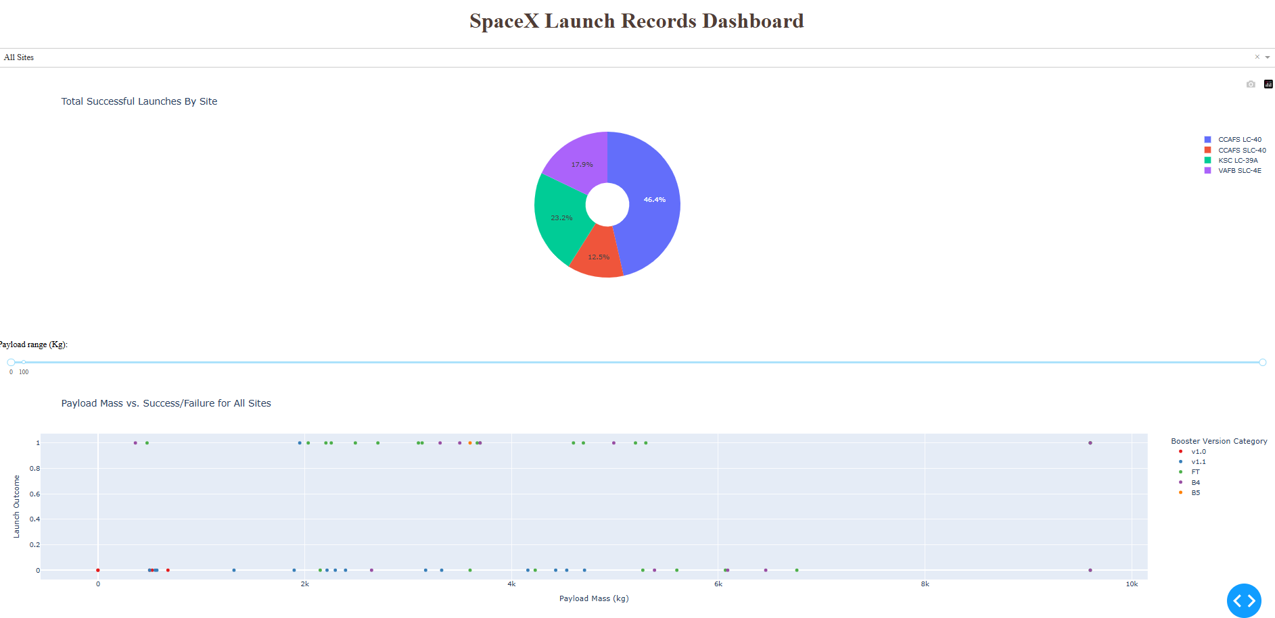
Results
There are relationships between FlightNumber and LaunchSite, PayloadMass and LaunchSite, ES-L1 / GEO / HEO / SSO / VLEO has 100% success rate while SO has no data, and GTO has the lowest success rate
Interactive analytics demo as right
Decision tree classifier gets the best results with accuracy of 0.875 on Training data and 0.833 on Testing data

Slide 17

Section 2

Slide 18
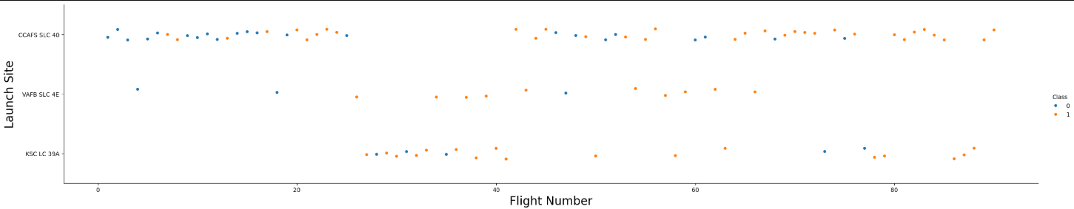
Flight Number vs. Launch Site
From flight Number 25 to 70, VAFB SLC 4E tends to fail
From flight number 0 to 18, CCADS SLC 40 tends to success, while after 40 it tends to fail, And KSC LC 39A tends to fail when flight number is between 36 to over 80

Slide 19
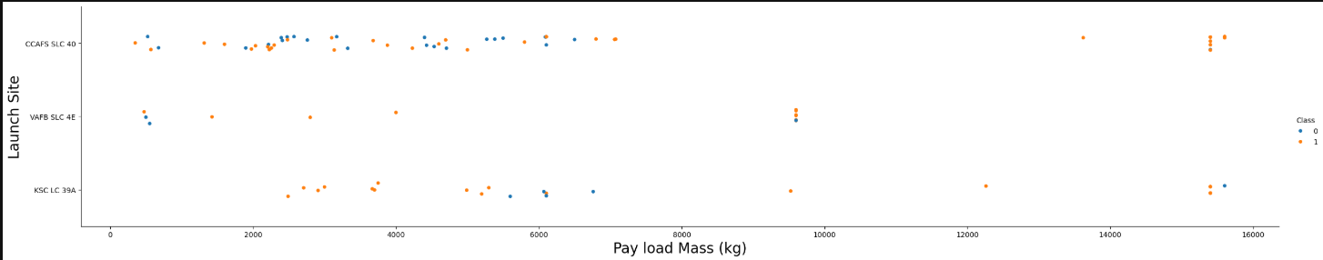
Payload vs. Launch Site
From Playload 2000 to 5500 kg and 9000 to 15500kg, KSC LC 39A tends to fail,
When Playload is over 13000, CCAFS SLC 40 always fails
CAFB SLC 4E tends to fail from 1800 to 9500 kg

Slide 20
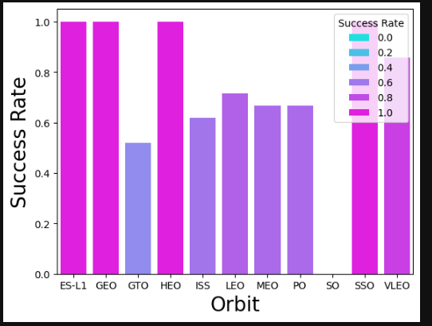
Success Rate vs. Orbit Type
ES-L1 & GEO & HEO & SSO & VLEO has 100% success rate
GTO has the lowest success rate around 50%
MEO & PO share the same success rate around 65%

Slide 21
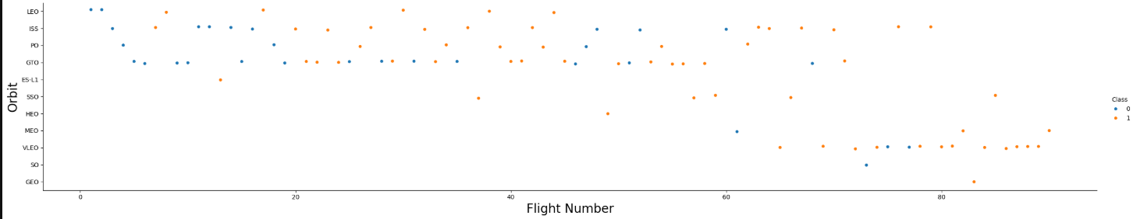
Flight Number vs. Orbit Type
GTO tends to success more when flight number is lower than 20 comparing with after 20 to 75
SSO & HEO & MEO & VLEO needs more than 40 flight numbers

Slide 22
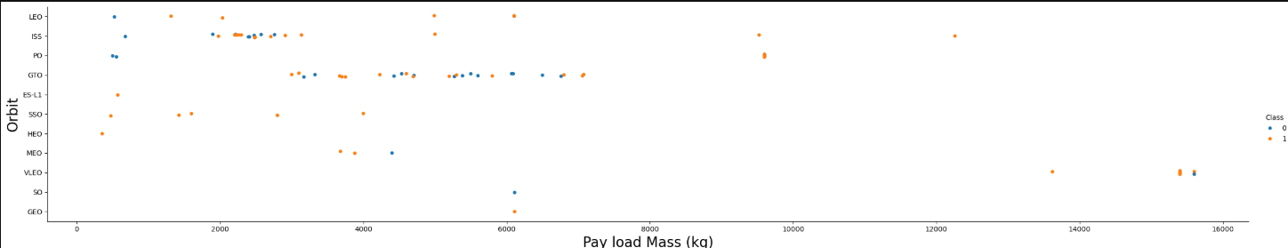
Payload vs. Orbit Type
GTO has payload mass from 3000 kg to 7500kg
LEO & ISS & PO tends to success when Playload Mass is around 1000kg

Slide 23
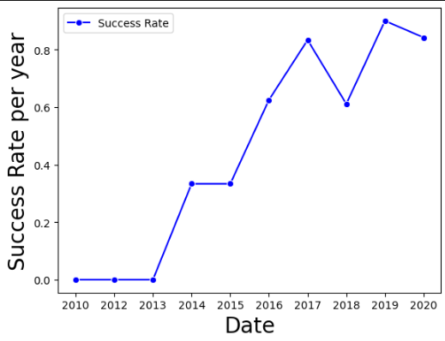
Launch Success Yearly Trend
The success rate is growing by year
2010 to 2013 are testing years where always fail
There is fluctuation from 2017 to 2020

Slide 24
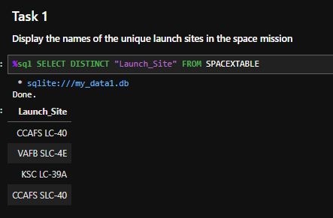
All Launch Site Names
Names of the unique launch sites:
CCAFS LC-40
VAFB SLC-4E
KSC LC-39A
CCAFS SLC-40

Slide 25
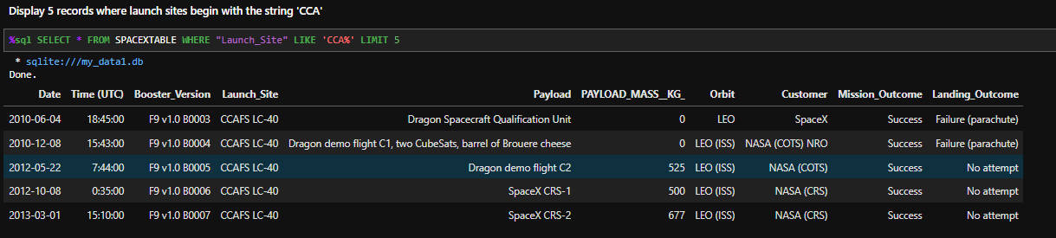
Launch Site Names Begin with 'CCA'
5 records where launch sites begin with `CCA` as below
They are all from Launch Site CCAFS LC-40, but Playloads are different, 4 of them sent by Nasa where 1 of them is from SpaceX, all 5 missions are success

Slide 26
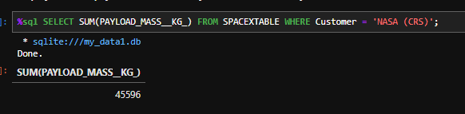
Total Payload Mass
Calculate the total payload carried by boosters from NASA

Slide 27
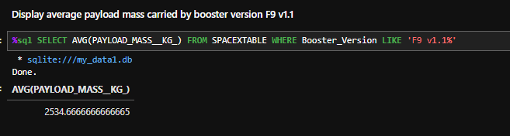
Average Payload Mass by F9 v1.1
Calculate the average payload mass carried by booster version F9 v1.1

Slide 28
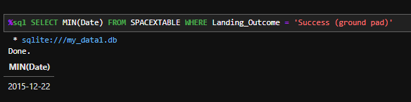
First Successful Ground Landing Date
Find the dates of the first successful landing outcome on ground pad
Use Min() to find the earliest date, use WHERE to find the ground pad successful landing outcome

Slide 29
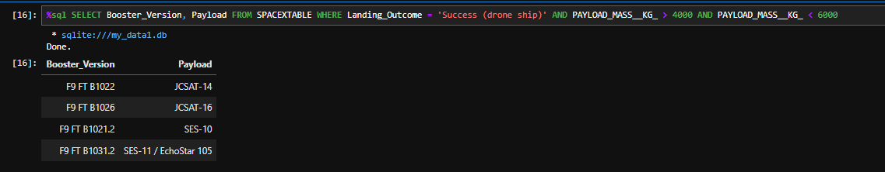
Successful Drone Ship Landing with Payload between 4000 and 6000
Names of boosters which have successfully landed on drone ship and had payload mass greater than 4000 but less than 6000:
F9 FT B1022 / F9 FT B1026 / F9 FT B1021.2 / F9 FT B1031.2
Use nested WHERE to filter landing outcome and payload mass

Slide 30
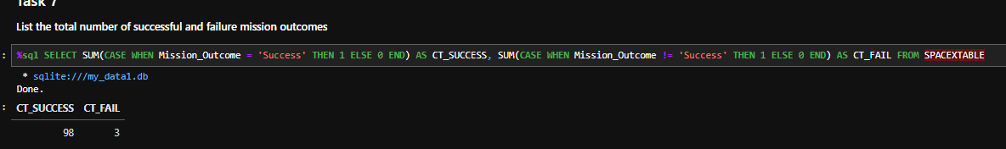
Total Number of Successful and Failure Mission Outcomes
Calculate the total number of successful and failure mission outcomes
Use CASE WHEN to assign different value to outcomes for 2 columns, one is for success and another is for failure

Slide 31
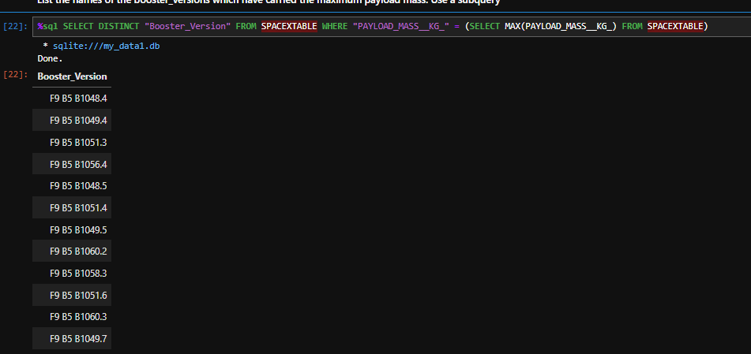
Boosters Carried Maximum Payload
List the names of the booster which have carried the maximum payload mass
Use subquery to find when playload is equal to the max value

Slide 32
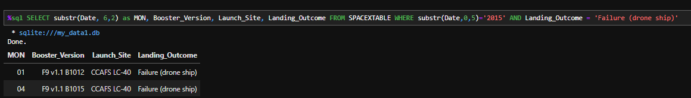
2015 Launch Records
List the failed landing_outcomes in drone ship, their booster versions, and launch site names for in year 2015
Use WHERE to limit the date starts with ‘2015’ year and landing outcome is failure for drone ship

Slide 33
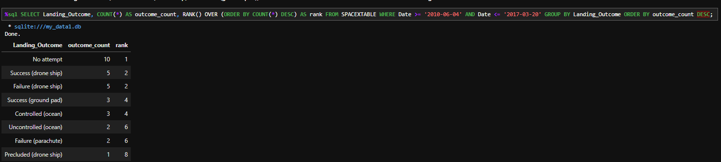
Rank Landing Outcomes Between 2010-06-04 and 2017-03-20
Rank the count of landing outcomes (such as Failure (drone ship) or Success (ground pad)) between the date 2010-06-04 and 2017-03-20, in descending order
Use ORDER BY to sort, and RANK() to go over the count and give the ranking for all types of landing outcomes

Slide 34

Section 3

Slide 35
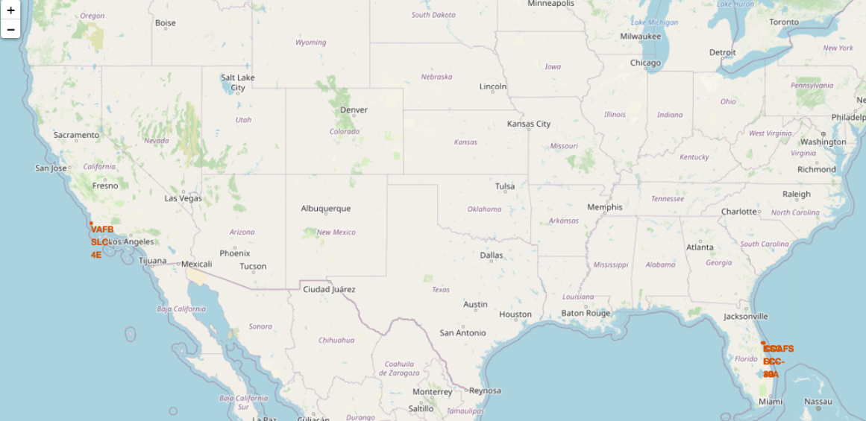
World Map of All Launch Sites
There are 3 sites on the east coast where only 1 in the west cost.
All of them are near to coastline

Slide 36
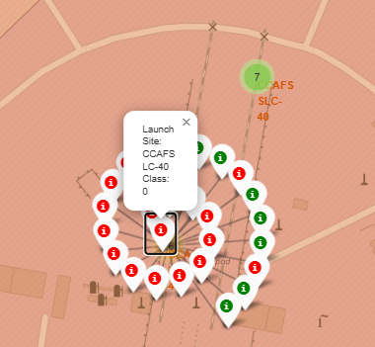
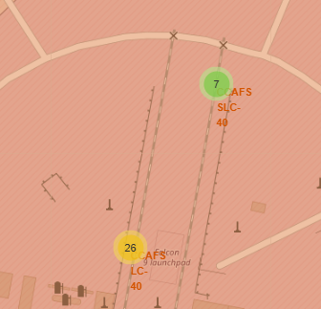
Folium Map with Color-labeled Outcomes
Green is Success while Red is Failure.
CCAFS LC-40 has 26 outcomes with most are failure
CCAFS SLC-40 has 7 outcomes with 3 success
KSC LC-39A has most outcomes as success out of 13 launches
VAFB SLC-4E has 4 out of 10 success launches

Slide 37
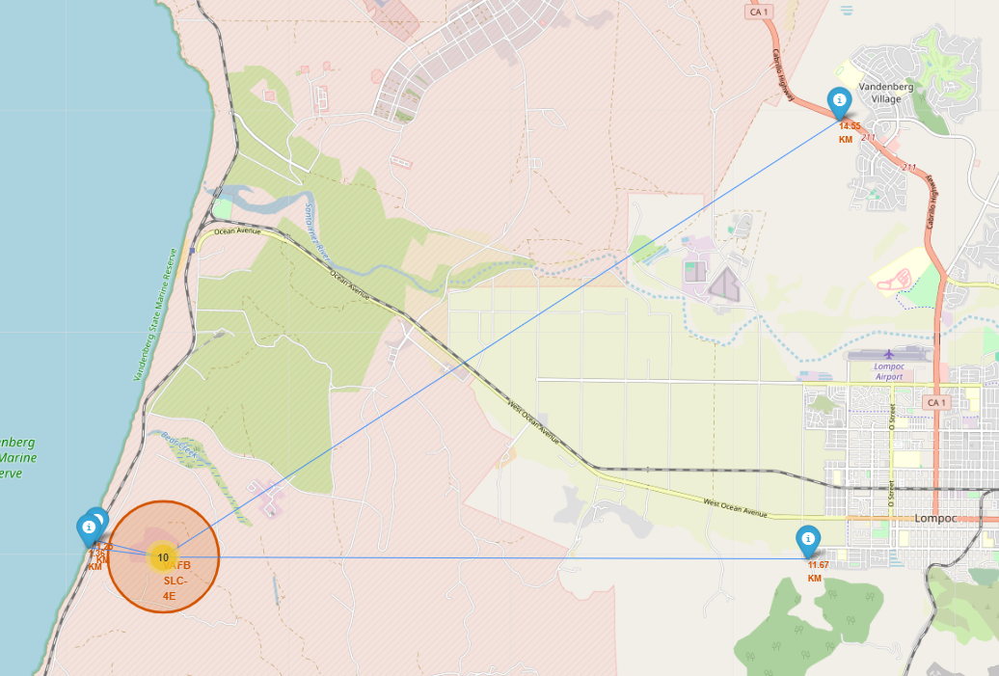
Folium Map Launch Sites to Proximities
VAFB SLC-4E is super close to Railway & Coastline with similar distances.
But it’s far from highway and city

Slide 38

Section 4

Slide 39
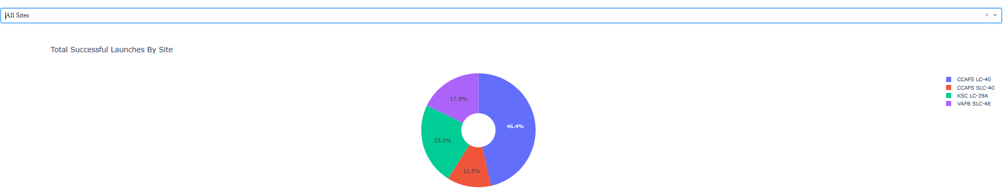
Dashboard Pie Chart for All Sites
CCAFS LC-40 has the most successful launches which is 46.4% out of all successful launches
And CCAFS SLC-40 has the least which is 12.5% of all successful launches

Slide 40
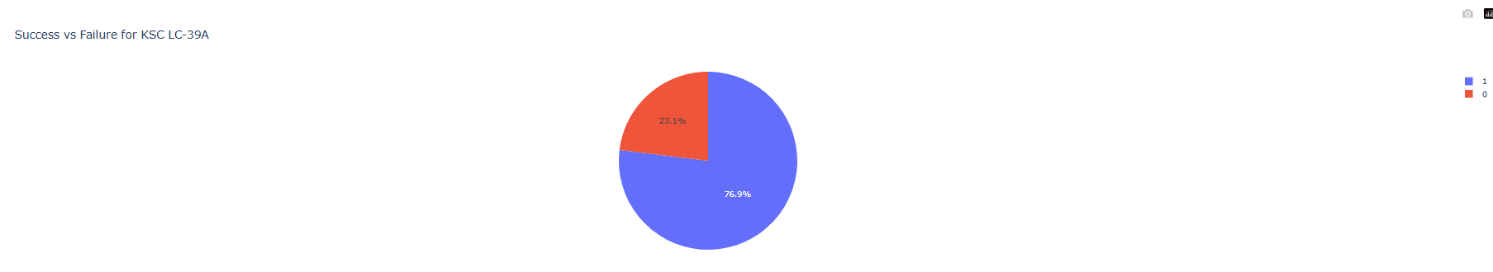
<Dashboard Screenshot 2>
KSC LC-39A has the highest success rate as 76.9%

Slide 41
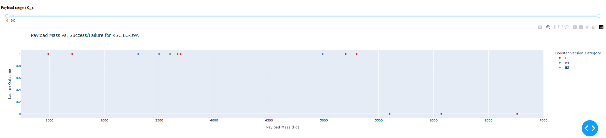
<Dashboard Screenshot 3>
When playloads are over 5500kg, booster FT always fail
When playloads less than 5500 kg, all boosters FT / B4 / B5 are successful

Slide 42

Section 5

Slide 43
Classification Accuracy
Decision Tree has the highest Accuracy

Slide 44
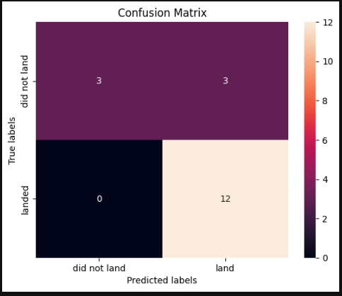
Confusion Matrix
There are in total 18 testing records
12 are true positives
3 are true negatives
3 are false positives
0 are false negatives

Slide 45
Conclusions
Sigmoid has the best performance from Support Vector Machine
Decision Tree is the most accurate as it considers all parameters
Logic Regression performs worst

Slide 46


